Slide 1
ECG Clustering Analysis
K-means, NbClust gap statistic, and hierarchical clustering
MIT-BIH Arrhythmia Database • AAMI class comparison
Massogona Cisse

Slide 2
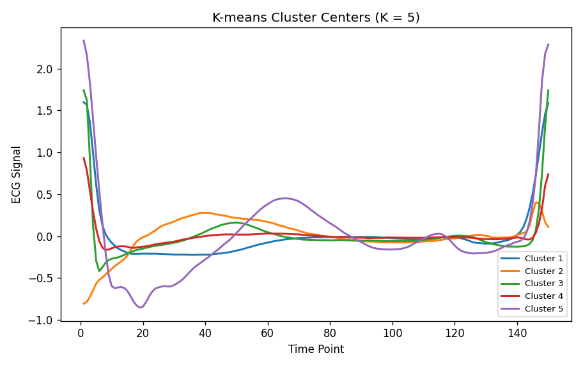
Motivation and Project Goal
ECG signals help monitor heart activity and detect arrhythmias.
Manual ECG review can be difficult when there are many heartbeat signals.
Clustering can group similar ECG waveform shapes without using labels.
Goal: compare the clusters with AAMI heartbeat classes.

Slide 3
Data and Preprocessing
1000 ECG observations
150 waveform variables
5 AAMI classes
Each row represents one heartbeat.
Columns X1–X150 represent ECG waveform values across time.
Annotations were recoded into AAMI classes: N, S, V, F, and Q.

Slide 4
Clustering Methods
K-means clustering was used as the main method.
NbClust with the gap statistic selected K = 2.
K-means clustering was also performed with K = 5.
Hierarchical clustering with complete linkage was implemented.
Results were compared using confusion matrices and PCA plots.

Slide 5
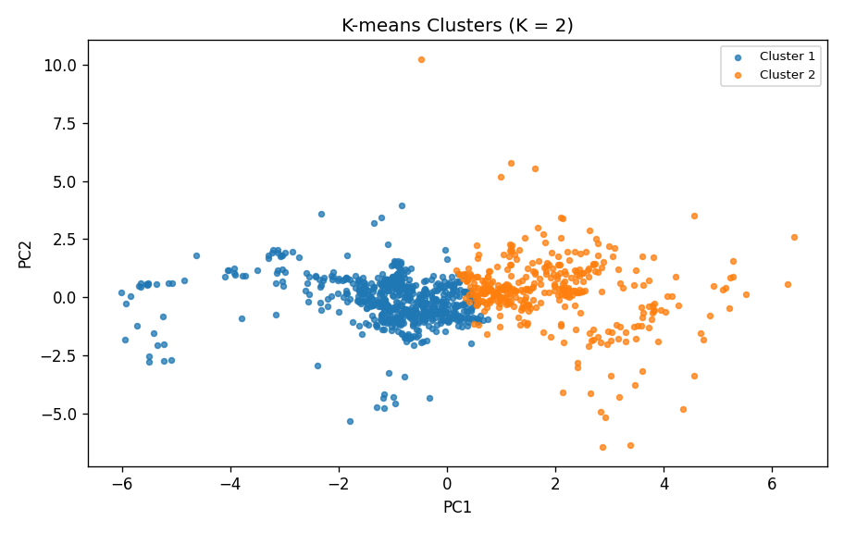
K-means with K = 2
Confusion matrix
AAMI | 1 | 2
F | 14 | 0
N | 286 | 533
Q | 22 | 54
S | 6 | 20
V | 28 | 37
Interpretation: K = 2 separates the data into two broad waveform groups, but several AAMI classes are combined in the same cluster.

Slide 6
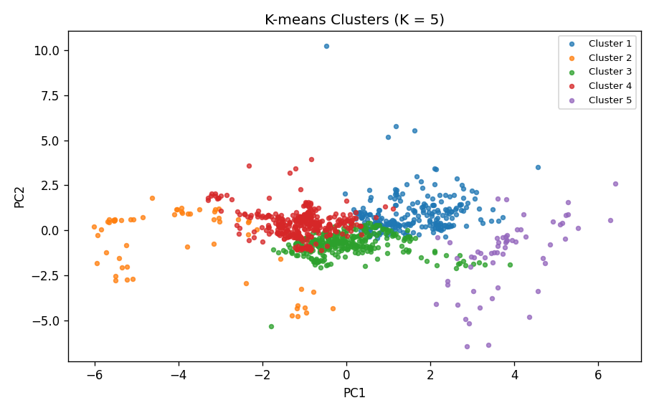
K = 5 with AAMI
Confusion matrix
AAMI | 1 | 2 | 3 | 4 | 5
F | 14 | 0 | 0 | 0 | 0
N | 196 | 317 | 30 | 1 | 275
Q | 5 | 0 | 0 | 23 | 48
S | 5 | 1 | 0 | 0 | 20
V | 22 | 16 | 19 | 0 | 8
Interpretation: K = 5 gives more detailed clusters. Fusion is grouped clearly, but Normal, Ventricular, and Unknown are spread across clusters.

Slide 7
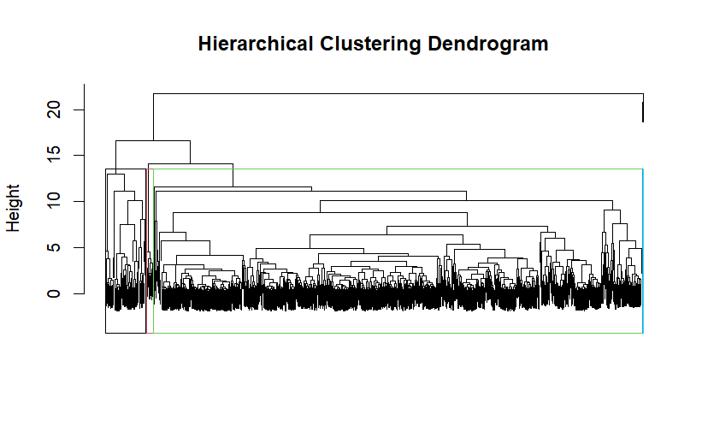
Hierarchical Clustering
Confusion matrix
AAMI | 1 | 2 | 3 | 4 | 5
F | 14 | 0 | 0 | 0 | 0
N | 775 | 43 | 0 | 1 | 0
Q | 51 | 11 | 14 | 0 | 0
S | 26 | 0 | 0 | 0 | 0
V | 42 | 22 | 0 | 0 | 1
Why HC? It gives a second clustering method and a dendrogram. Result: one large cluster contains many classes, so separation is weaker.

Slide 8
Cluster Centers: Average ECG Shapes
Each line is the average waveform for one K-means cluster.
This plot helps show how clusters differ in ECG shape.
It supports the interpretation that K = 5 provides more detailed waveform patterns.

Slide 9
Comparison of Clustering Methods
K = 2 captured broad waveform patterns.
K = 5 produced more detailed grouping patterns.
K-means with K = 5 gave the most meaningful results.
Hierarchical clustering showed weaker separation

Slide 10
Conclusion
Clustering identified general ECG waveform patterns.
The heartbeat classes were not perfectly separated.
K-means with K = 5 produced the best overall results.

